Slide 1
TEAM MISSISSIPPI Members: 1.Subhrajyoti Soumyadarsan(B120065) 2.Sruti Pingua(B120064) 3.Musaib Altaf(B120061) 4.Ragini Sharma(B120062) 5.Vatsyayana(B120063)

Slide 2
ELEMENTS OF COMMUNICATION
INDEX:
What is communication?
What are communication models, factors and principles?
What is verbal and non-verbal communication?
What are the requirements for a successful communication?
What could be the issues in communication?

Slide 3
ELEMENTS OF COMMUNICATION
INDEX:
What is semiotics?
How does Dialects and Language affect a communication?
What is the difference between the Oral and Written Business communication?
What is the most important factor in a business communication?
What should be the requites of a well furnished communication?

Slide 4

Good Afternoon!
Team Mississippi
is here to answer to all the above questions and evoke a sense of understanding on what does really communication signifies and how does it affect us!

Slide 5
What is COMMUNICATION?
Is it a thing, feeling, process or something else! Let’s find out:

Slide 6

COMMUNICATION
It is the process of creating, interpreting and transacting the meaning.
It can be verbal, non-verbal or textual.
It can be oral, visual and physical.
To be enough aphoristic, Communication is a mutual and collaborative process in which communicators engineer the process, result and the effectiveness of the interaction.

Slide 7
Models of Communication
In order to explain the social process of communication, we went through three models:
LINEAR
INTERACTIONAL
TRANSACTIONAL

Slide 8
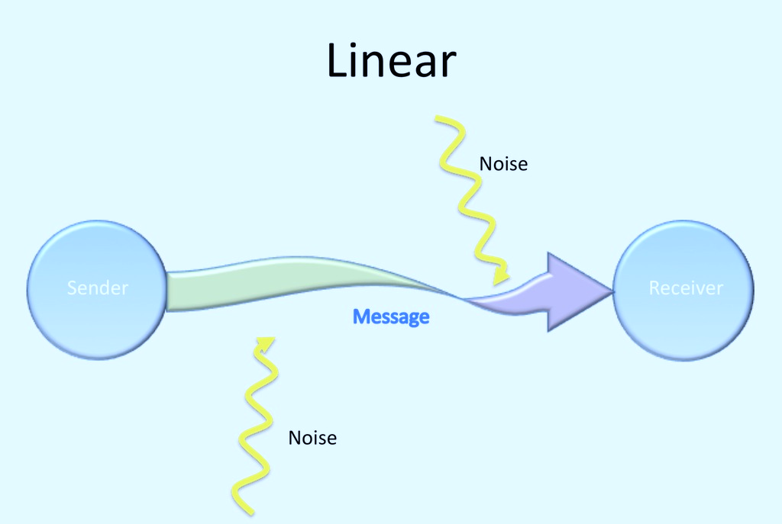
LINEAR MODEL OF COMMUNICATION
LINEAR MODEL
DEVELOPED BY SHANNON AND WEAVER IN 1948.
IN LINEAR MODEL, SENDER IS THE SOURCE AND RECIEVER IS THE TARGET OR RECIPIENT OF THE MESSAGE.
THE MESSAGE MAY CONSIST OF SOUND, WORDS OR BEHAVIOR.
NOISE REFERS TO THE INTRUSION OR INTERRUPTION IN THE COMMUNICATION.
MERITS
HIGHLY INFLUENTIAL DURING 20TH CENTURY.
LUCID TO UNDERSTAND.
LIMITATIONS
THE COMMUNICATION IS UNIDIRECTIONAL (i.e.) AN INDIVIDUAL CAN’T BE THE SENDER AND RECIEVER SIMULTANEOUSLY
LINEAR MODEL PROVIDES ONLY ONE CHANNEL FOR ONE MESSAGE.

Slide 9
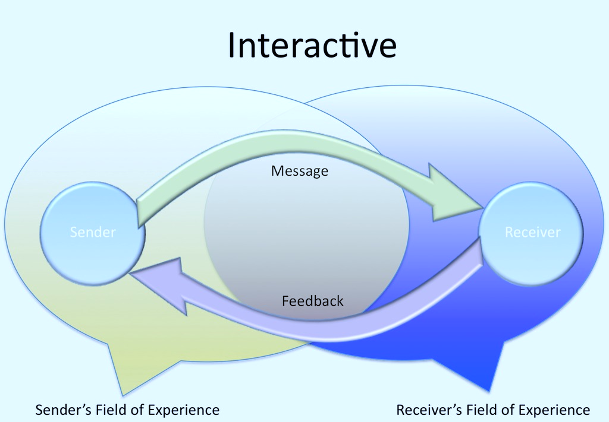
INTERACTIONAL MODEL OF COMMUNICATION
INTERACTIONAL MODEL
THIS ENABLES THE RECIEVER TO GIVE FEEDBACK.
FEEDBACK IS SIMPLY A RESPONSE THAT THE RECIEVER GIVES TO THE SENDERS MESSAGE. IT CAN BE VERBAL(YES/NO) OR NON-VERBAL(NOD/SMILE).
IT DEPICTS THE COMMUNICATION AS AN ONGOING PROCESS.
MERITS
IT PROVIDES A MORE DYNAMIC VIEW OF COMMUNICATION.
INTERACTION IS BI-DIRECTIONAL IN NATURE.
FEEDBACK GIVEN HERE DECIPHERS COMPREHENSION. IT LETS THE SENDER KNOW THAT WHETHER THE MESSAGE IS TACIT TO RECIEVER OR NOT.
LIMITATIONS
AN INDIVIDUAL CAN BE A SENDER AND RECIVER, BUT CAN’T PERFORM BOTH THE JOBS SIMULTANEOUSLY.
THE ROLES ARE NOT THAT LIMPID RATHER THEY ARE MUCH FLUID.

Slide 10
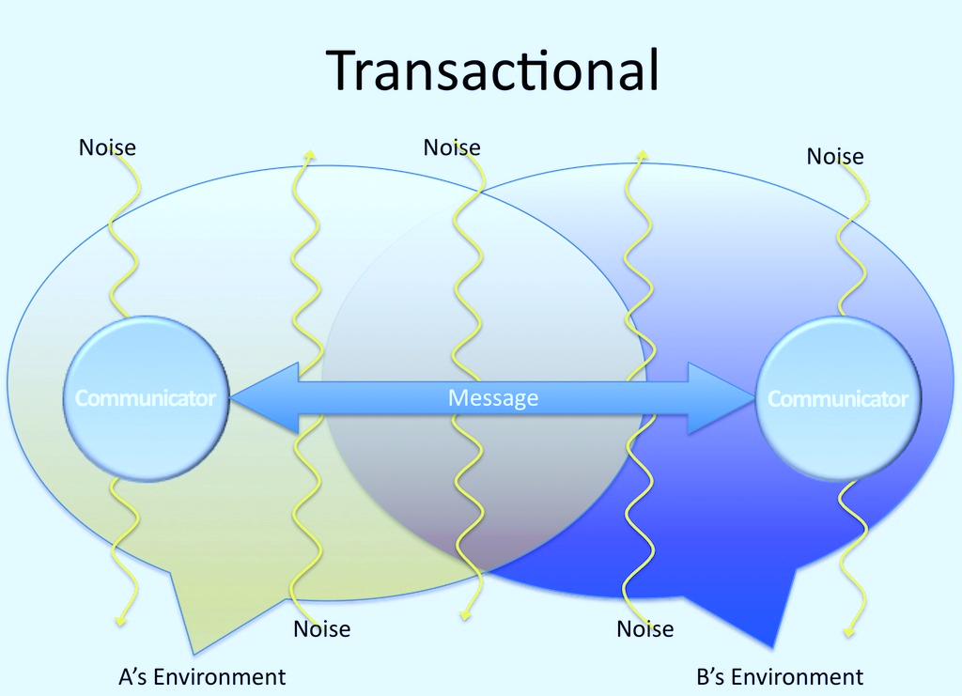
TRANSACTIONAL MODEL OF COMMUNICATION
TRANSACTIONAL MODEL
ALL THE PEOPLE EITHER SENDERS AND RECIEVERS ARE REFERRED TO AS COMMUNICATORS.
THIS MODEL DEPICTS COMMUNICATION AS A TRANSACTION.
EACH COMMUNICATOR HAS A SOLITARY FIELD OF EXPERIENCE, BUT THEY MUST INHABIT A SHARED FIELD OF EXPERIENCE.
SHARED FIELD OF EXPERIENCE MEANS THAT THEY MUST SHARE SOME DEGREE OF OVERLAP IN CULTURE, LANGUAGE AND ENVIRONMENT
MERITS
LIMITATIONS
THERE COULD BE CHANCES OF INCREASED NOISE AS MULTIPLE CHANNELS ARE INVOLVED SIMULTANEOUSLY.
PEOPLE ARE SIGNIFIED AS DYNAMIC CONTRIBITORS IN COMMUNICATION RATHER THAN SIMPLE SENDER AND RECIVER.
MESSAGES ARE INTERDEPENDENT.
PEOPLE MUST SHARE SOME FIELDS IN ORDER TO MARGIN A SHARED MEANING.

Slide 11
SEMIOTICS
SEMIOTICS
Signifier:
It is actual form of sign. It may appear as words, images, sounds, etc.
Signified:
It is the meaning that is associated with the form of signifier.
It is the study of signs.
It was pioneered by French Philosopher Ferdinand de Saussure.
A sign’s meaning always depends on its context.
According to Berger(2007), consumers never actually purchase the advertised products, instead they purchase the ideas, or meanings, present in the advertising image.
Unlike a symbolic sign, an indexial sign holds an inherent relationship between a sign and its meaning.

Slide 12

REQUISITES OF A SUCCESSFUL ORAL BUSINESS COMMUNICATION
Pre-Planned: The speaker can prepare the context before the presentation beforehand, so that it is easy for the presenter to transmit the message. Pre-planned communication is always fruitful.
Accuracy: The speaker must speak properly and accurately while communicating with the audience. The subject matter should be precise enough to avoid any confusion.
Conciseness: The context should contain limpid and relevant data, so as to catch the attention of audience.
Attractive Presentation: The speaker should maintain a good body language, a nice tone, a catchy attitude to involve the audience in real-time.

Slide 13

REQUISITES OF A SUCCESSFUL ORAL BUSINESS COMMUNICATION
Consideration of receiver or audience: The speaker should blend a good knowledge and experience about the requirements of the present audience like use of language everyone comfortable with and plausible technique of delivering the message.
Neutrality: The speaker should try to avoid using biased language, whether that is gender bias, religious bias and ethnicity bias. It is very informal to speak biased language.
Realistic and simple: Realistic information holds the attention of readers and doesn’t let the concentration split down. Simple language does the same job. It conveys the information in a better manner.
Knowledgeable: During addressing of the information the presenter should know all the loop holes of the topic and should be able to solve them right at the moment, if any such misinterpretation arises.

Slide 14

REQUISITES OF A SUCCESSFUL WRITTEN BUSINESS COMMUNICATION
Easy Language: The language used in writing the document should be lucid and understandable to the reader. It makes the communication more effective.
Structure: Every business document must follow a definite structure. We should take care that what should be figured as the header, what in the body and what in the end.
Accurate and precise: The written business documents should be accurate and precise. Accurate in the sense that the context should be logical and relevant to prevent the concentration from splitting. Precision follows the same rule.

Slide 15

REQUISITES OF A SUCCESSFUL WRITTEN BUSINESS COMMUNICATION
Conversation Tone: The document should be in direct speech so as to margin a conversational tone in the document.It holds the readers attention and makes the document interesting.
Error-less: The document should be free from any sort of errors and flaws, which leaves a good impression on the reader.
Personal and Organizational images: A good written communication bears the images or logos of the organization or the writer. It makes the document interesting.
Context: Context refers to the setting in which communication takes place. The context helps establish meaning and can influence what is said and how it is said .

Slide 16
PARADIGMS OF REPRESENTATION
Reflective
Here the language acts like a mirror to reflect meanings that exist in objects and in the environment.
Intentional
Words mean what their author intends them to mean.
Constitutive
Reality is a product of communication. Closely associated with social constructionism.

Slide 17
GST: GENERAL SYSTEMS THEORY
SYSTEM
Object:
Refers to the parts of a system.
Attributes:
Refers to the quality of objects.
General Systems Theory (GST) is used to study the nature of complex systems. Systems are collections of different elements that work together to form a cohesive unit.

Slide 18
OPEN SYSTEMS
Wholeness:
Complete Subject is treated one as a whole.
Interdependence:
All subjects are dependent on one other in one form or other.
Nonsummativity:
Information not to be submitted to any particular individual.
Relationship:
There should be coordination between subjects.
Feedback:
The reply from the receiver should be received and implemented if required.
Circularity:
The pattern of recurring information should be followed.
Equitinality:
Achieving same goals by different means.

Slide 19
BIASED AND UNBIASED LANGUAGE:
Biased
The term "biased language" refers to words and phrases that are considered prejudiced, offensive, and hurtful. Biased language includes expressions that demean or exclude people because of age, sex, race, ethnicity, social class, or physical or mental traits.
Bias in language refers to language that is uneven or unbalanced or not a fair representation.
Unbiased
Unbiased language is free from stereotypes or exclusive terminology regarding gender, race, age, disability, class or sexual orientation.
By using bias free language, we are ensuring that our content does not exclude, demean or offend groups in society. Consciously avoiding bias in writing is important as this kind of language can encode and enforce harmful messages about the superiority or inferiority of different people.

Slide 20
BIASED AND UNBIASED LANGUAGE:
Biased
If he is elected, he would be the first person of color in the White House.
Unbiased
lf he is elected, he would be the first African-American in the White House.
He has had the physical impairment since he was 5 years old.
He has had the physical handicap since he was 5 years old.
There are many old people in our town.
There are many senior citizens (or seniors) in our town.

Slide 21
Verbal and Non- Verbal Communication:
 | Verbal Communication | Non- Verbal Communication
Medium of communication | Verbal communication uses language, words, sentences, and voice as the medium of communication. | Nonverbal communication uses body language, facial expressions, tone, and pauses in speech as the medium of communication.
Channels of communication | Verbal communication uses a single channel of communication, the human voice, which speaks a single word at a time. | Nonverbal communication uses multiple channels of communication including your entire body, facial expressions, and tone of voice.

Slide 22
Verbal and Non- Verbal Communication:
 | Verbal Communication | Non- Verbal Communication
Examples of communication | Verbal communication can take place over a phone call, in a face-to-face conversation, over loudspeakers, through audio recordings, and so on. | Nonverbal communication can only occur when all the parties in the conversation can see each other. This helps them properly understand what they are communicating nonverbally.
Mode of communication | Verbal communication is linear and voluntary. You set out to say something, gather your thoughts, form your sentences, and then start delivering your message. It is a well-thought-out process in which the speaker focuses on communicating their message effectively. | Nonverbal communication is a continuous process. It is not well-thought-out and is largely involuntary, although you can train yourself to use it more purposefully. Unlike verbal communication, nonverbal communication is not linear. It depends more on how one uses their body language and other cues to respond to external stimuli.

Slide 23
Verbal and Non- Verbal Communication:
 | Verbal Communication | Non- Verbal Communication
Consciousness in communication | Verbal communication is a conscious process. It involves thinking, processing, and articulating. | Nonverbal communication happens on an unconscious level. One doesn't really think about it actively
Decoding the communication | Verbal communication is fairly easy to decode if you understand the language and the words being used. When you pay close attention to the person who is speaking, you will understand what they are saying. | Nonverbal communication is a little harder to decode than verbal communication. You have to pay attention to many factors including the speaker’s body language, facial expressions, and tone to decode what the other person is trying to convey

Slide 24
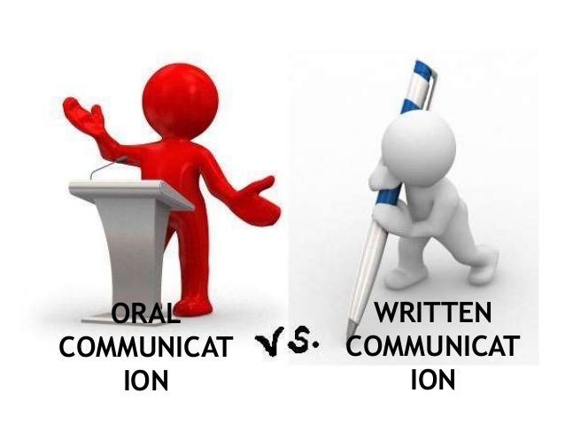
Written vs spoken communication
Imagine for a moment that you’re a college student who is struggling with material in a class. Rather than simply giving up, you decide that you’re going to ask your instructor for the guidance you need to make it through the end of the semester. Now, you have a few choices for using verbal communication to do this. You might choose to call your instructor, if they’ve provided contact information, or talk to them in person after class or during office hours. You may take a different approach and send them an email. You can probably identify your own list of pros and cons for each of these approaches. But really, what’s the difference between writing and talking in these situations? Let’s look at some of the major differences between the two:
Formal versus Informal: We generally use spoken communication informally while we use written communication formally.
Synchronous versus Asynchronous: Synchronous communication is communication that takes place in real time, such as a conversation with a friend. In contrast, asynchronous communication is communication that is not immediate and occurs over longer periods of time, such as letters, email, or even text messages.
Recorded versus Unrecorded: Written communication is generally archived and recorded for later retrieval while spoken communication is generally not recorded.

Slide 25
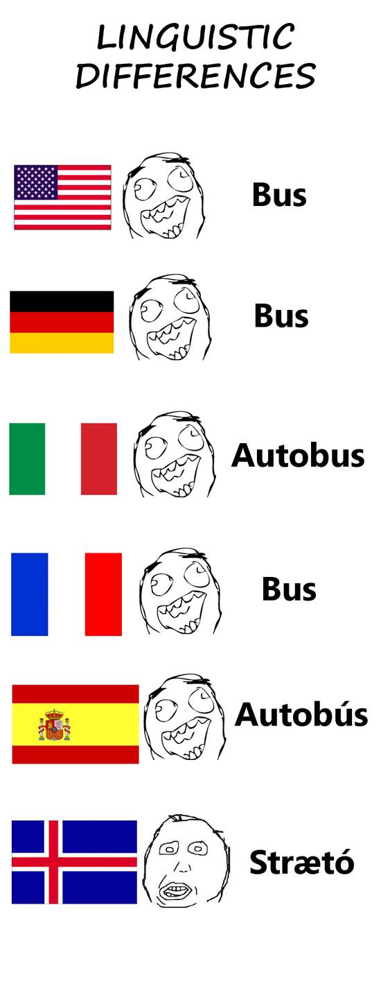
CASE STUDY : linguistic Difference
English is the language to speak when we talk across cultures. In Israel, English entered the workplace along with the global hi-tech boom. Numerous Israeli companies use English within the workplace, despite being located in mainly Hebrew-speaking Israel, because so much of their business is conducted with the international market. And even though many Israelis have a relatively good command of English, it’s still their second language, and what they say and write is not always readily understandable to people from other cultures.
Some senior American and Israeli managers were on a conference call. The topic of the call was transitioning from an on premise product to a cloud-native product. In the middle of the discussion, one Israeli manager said that the R&D staff in Israel ‘don’t care’ about some of the changes. An American manager, although usually polite, couldn’t restrain himself when he heard that statement. “What’s that supposed to mean, they DON’T CARE??” he thundered. This is a great example of a wrong expression giving the wrong impression. The Israeli manager’s intention got lost in translation since English is his second language. What he meant by ‘don’t care’ was that it wouldn’t make a big difference, didn’t matter, didn’t bother them – the correct English phrase would be ‘don’t mind.’ (The two terms seem so close to the Israeli ear and mind… practically identical… almost a synonym.)Due to lack of knowledge or not understanding the nuances of a language, many Israelis often make usage mistakes. Another example is the English word ‘issue,’ which has been adopted in Hebrew as a cognate meaning topic or subject, whereas Americans tend to perceive the word with a negative connotation – like a problematic topic or subject. The distinction is liable to ruffle some feathers; if an Israeli innocently says, “I have an issue to bring up,” an American will already be on the defensive before another word is even spoken.

Slide 26
SOME BARRIERS TO COMMUNICATION
Physical Barrier
Physical barrier is the environmental and natural condition that act as barrier in communication. Organizational environment or interior workspace design problems, technical problems and noise are the parts of physical barriers.
Perceptual Barriers
Perpectual barriers are the mental blocks that we create because of the perceptions that we have of certain people, situations or events around us. If the senders’ and receivers’ perceptions are not alined, it can be a significant source of barrier in the communication process.
Emotional Barriers
Emotional barriers are the mental walls that keep you from openly communicating your thoughts and feeelings to others. They prevent you from being yourself and living your life to the fullest. Indiviuals with emotional barriers tend to be extremely reserved, cautious and insecure.
Cultural Barriers
Cultural barriers are challenges to cross- cultural communication within an organization. When people from different cultures who might speak different languages, have different cultural beliefs or use different gestures and symbols to communicate, their cultural differences might become barriers to workplace success.
Language Barriers
Language is needed for any kind of communication, even people with speech impairments communicate with sign language and brail. Communication becomees difficult in situations where people don’t understand each others’ language. The inability to communicate using a language is known as language barrier to communication. Language barriers are the most common communication barriers which cause misunderstandings and misinterpretations between people.
Gender Barriers
Gender barriers to communication can incite problems at home and in the workplace. Societal stereotypes, assumed gender roles, and interpersonal differences can contribute to a communication gap between the genders’.

Slide 27
SOME BARRIERS TO COMMUNICATION
Interpersonal Barrier
An interpersional barrier is something that prevents an effort to communicate between two or more people. Stage fright, a language barrier, the state of grieving, a stroke involving the speech area are examples. An interpersonal conflict involves the selfand selves being blocked by a misconception, incorrect facts, a state of shame and delusions, anger that is unresolved, prejudice, previous lack of success in communicating about a difficult topic such as work performance, video game obsession, etc.Interpersonal conflict requires at least two people attempting to communicate about a barrier that leaves a significant gap in acceptance or understanding.
Semantic Barrier
The semantic barriers refers to the misunderstandings between the sender and receiver arising due to the different meanings of words, and other symbols used in the communication. The semantic barriers usually arise when the information is not in the simple language and contains those words or symbols that have multiple meanings.
Organizational Barrier
The organizational barriers refers to the hindrances in the flow of information among the employees that might result in a commercial failure of an organization. The factors related to organization structure, authority relationships, rules and regulations may, sometimes act as barriers to effective communication.

Slide 28
ELEMENTS OF A SUCCESSFUL BUSINESS COMMUNICATION
Clarity
Completeness
Consideration
Courtesy
Correctness
Conciseness

Slide 29
ELEMENTS OF A SUCCESSFUL BUSINESS COMMUNICATION
CORRECTNESS
CLARITY
Give the correct facts: Business communication often leads to expensive operations. So you should be sure that you are using correct facts and expressing them with the correct language. In fact, you should not transmit any message unless you are absolutely sure of its correctness.
Send your message at the correct time: All messages must be transmitted and responded to at the most appropriate time. Outdated information is useless. In fact, since communication is an expensive process, transmitting outdated information involves wastage of time, money, and human resources. The principle of correct timing also stipulates that you communicate your message at a time when it is likely to prove most effective.
Send your message in the correct style: This may also be described as the principle of adaptability. You must adapt your message to the needs of the receiver. You must keep before his educational background, the width of his vocabulary, specialized knowledge of the subject, his psychological make-up, etc.
Clarity of thought: The communication cycle begins with the generation of an idea in the mind of the transmitter. A huge deal of clarity is needed at this stage, for if the beginning is fuddled, it is likely to mar the entire communication process. The communicator should be clear about three points which are as follows:
What are the objectives of communication?
What is to be communicated?
Which media is suitable for our communication purpose?
Clarity of expression: The receiver learns about the idea in the transmitter’s mind through the coded message. If encoding is faulty, the message may be misinterpreted. So everyone should more careful while encoding the message. Since most of the messages are transmitted with the help of words, the transmitter should be careful about the meanings and organization of words.

Slide 30
ELEMENTS OF A SUCCESSFUL BUSINESS COMMUNICATION
CONCISENESS
CONSIDERATION
A reader’s time is invaluable. Don’t make him feel that he is wasting his time in going through your unnecessarily lengthy letter. Be as brief as possible. Brevity in expression effectively wins the attention of the reader.
However, brevity should not be affected at the cost of appropriateness, clarity, correctness, completeness or courtesy. There is no hard and fast rule for the length of a letter.
A letter should be as long or as short as is necessary to tell the story effectively. A two-page letter may seem short, while a ten-line letter may seem all too long.
Avoid the following :
Unnecessary details
Repetition
Trite and wordy expressions
In our letters, we must show consideration for the reader. This can be done in the following ways:
Adopt the “You” attitude: Each person is naturally interested to hear his name. So when we write letters, we should write from a third party. It means that we must avoid I’s and use as many Yours as possible.
Emphasize positive, pleasant facts: When we communicate we must have a positive approach towards the receiver. On many occasions we have to refuse, ‘no’, regret, disagree, and say ‘sorry’. These are negative approaches that are straight forward and the effect is far-reaching on the reader’s mind. Whereas a positive approach convinces the reader and retains the goodwill of the firm. For eg,
Negative: We regret to inform you that we will not be able to execute your order
Positive: Thank you for your order. The goods should be sent to your address as soon as possible.

Slide 31
ELEMENTS OF A SUCCESSFUL BUSINESS COMMUNICATION
COURTESY
COMPLETENESS
In business, we must create friendliness with all those to whom we write. Friendliness is inseparable from courtesy. And courtesy demands a considerate and friendly behavior towards others. The principles which are given below help to promote courtesy:
Answer the letters promptly: In business, it is a general practice to answer a letter the same day it is received. Sometimes you might need a past reference, or may have to refer to different departments for clarification of certain points, or may need the consent of higher authorities.
Omit irritating expressions: Some words and expressions are negative in connotation and irritate the reader. Particularly expressions like ‘you forgot’, ‘you failed’, and your irresponsible approach are bound to irritate or hurt the reader. So totally avoid them. Some other such expressions are: You are probably ignorant/unaware, You neglected/ignored/overlooked/disregarded, Inexcusable/irresponsible/odious/obnoxious, We disagree with you/we do not believe/you leave us any choice, etc.
Apologize sincerely for omission/thank generously for a favor: If you have overlooked or failed to do something, express your regrets promptly and sincerely and make up for the omission at the earliest.
In business communication, the completeness of facts is necessary. Incomplete communication irritates the reader, for it leaves him baffled. If wrong actions follow an incomplete message, they may also prove expensive.
Let us -suppose you are ordering shirts by mail. Your communication must include all the relevant facts-size, color, catalog number, quantity, mode of payment, mode of dispatch, the date by which.
You need shirts, etc. In the absence of any of these details, your order may not be filled to your satisfaction. You should organize your message in such a way that the receiver is not in doubt about anything contained in it.

Slide 32
FACTORS AFFECTING EFFECTIVE PRONOUNCIATION
Vowels: A vowel is a syllabic speech sound pronounced without any structure in the vocal tract .It may vary in quality ,in loudness and also in quality .
Consonant: A basic speech sound in which the breadth is at least partly obstructed and which can be combined with a vowel to form a syllable .
Diphthongs: A sound formed by the combination of two vowels in a single syllable , in which sound begins as one vowel and moves towards another .
IPA: The international Phonetic Alphabet is an alphabet system of phonetic notation based primarily on the Latin script.

Slide 33
WAYS FOR CONVEYANCE OF MESSAGE
Presentation :A speech or talk in which a new product , idea , or piece of work is shown and explained to an audience .
Meeting : A meeting is when two or more people come together to discuss one or more topics, often in a formal or business setting .
Interviews : An interview is essentially a structured conversation where one participant asks questions , and the other provides answers .
Group Discussion : It is a group of individuals , typically who shares a similar interest , who gather either formally or informally to discuss ideas , solve , problems ,or make comments .
Dialogue : A conversation between two or more people as a feature of a book , play or film.
Code : Code in communication , an unvarying rule for replacing a piece of information such as a letter word or phrase with an arbitrarily selected equivalent .

Slide 34
DIALECTS and accent
DIALECTS
Regional Dialects:
Associated with a geographic area and these are slowly fading due to media and mobility
Social Dialects:
Associated with a social /ethnic group, not spoken by all members of the group and many speakers can shift styles.
DIALECTS
ACCENT
A particular form of a language which is peculiar to a specific region or social group.
A dialects is distinguished by its vocabulary , grammar , and pronunciation and by its use by a group of speaker who are set off from others geographically or socially.
Accent is a manner of pronunciation peculiar to a particular individual, location or nation.
An accent may be identified with the locality in which the speakers reside, the socioeconomic status of its speakers, their ethnicity, their caste or social class, or influence from their first language.

Slide 35

SOCIETY is not born, but made and it is not the fulfillment of results , it’s a journey on the roads of COMMUNICATION.

Slide 36
CREDITS
https://www.skillsyouneed.com/ips/what-is-communication.html
https://www.google.com/search?q=wikipedia&oq=wikipedia&aqs=chrome..69i57j0j0i433j69i60j69i65.4074j0j7&client=ms-android-samsung-gs-rev1&sourceid=chrome-mobile&ie=UTF-8
https://ecampusontario.pressbooks.pub/evolutionhumancommunication/chapter/chapter-1/#:~:text=The%20three%20most%20well%20known,Linear%2C%20Interactional%2C%20and%20Transactional
https://harappa.education/harappa-diaries/verbal-and-nonverbal-communication

Slide 37



